Slide 1

Handwriting Sentiment Classifier
Ernawaty, Xiao Yao, Rachel Chuang

Slide 2

Topics of Discussion
Datasets Collection and Cleaning
Features Analyzed (Handwriting characteristics)
Model Training
Challenges

Slide 3
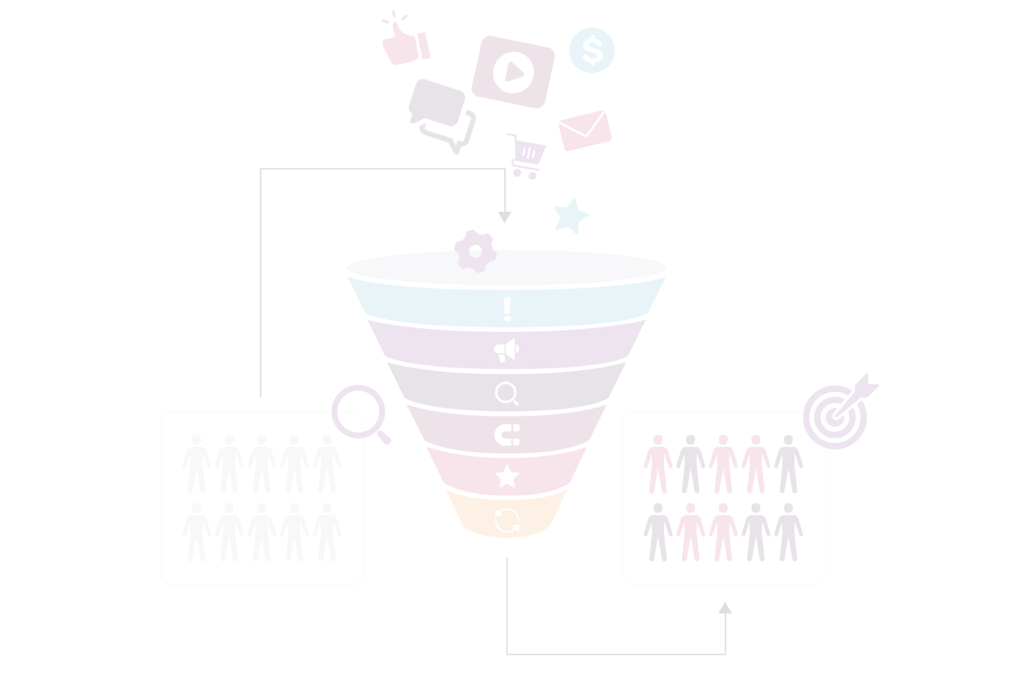
Data Collection and Cleaning
Data Quality and Diversity
Handling missing and irrelevant data
Standardization and Normalization
Notes:
Data Quality and Diversity: The dataset includes handwritten text samples and sentiment labels. Data was sourced from multiple contributors to ensure diverse handwriting styles and sentiments.
Handling Missing and Irrelevant Data: Preprocessing steps removed rows with null values and duplicates, improving overall data quality.
Standardization and Normalization: Handwritten samples were standardized in size and format. Text normalization techniques ensure consistency across entries.
Ethics: The dataset utilized is a published collection, ensuring compliance with ethical standards in data collection and usage.

Slide 4

Variable Analyzed
Number of stroke
Pressure
Altitude
Azimuth

Slide 5
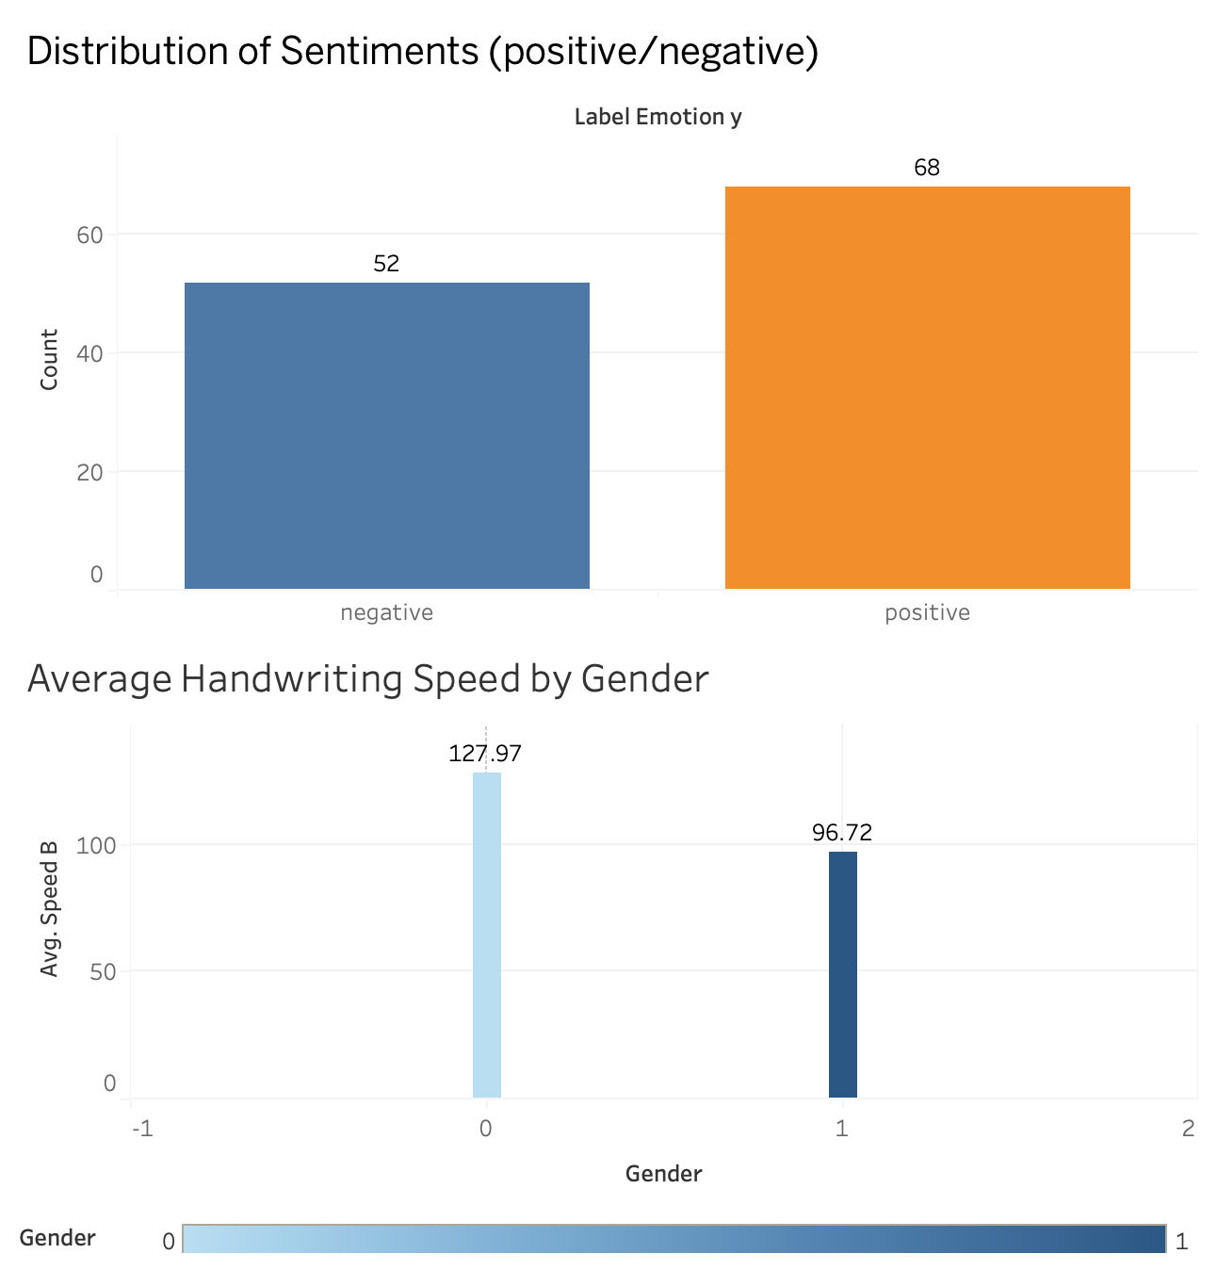
Graphs

Slide 6
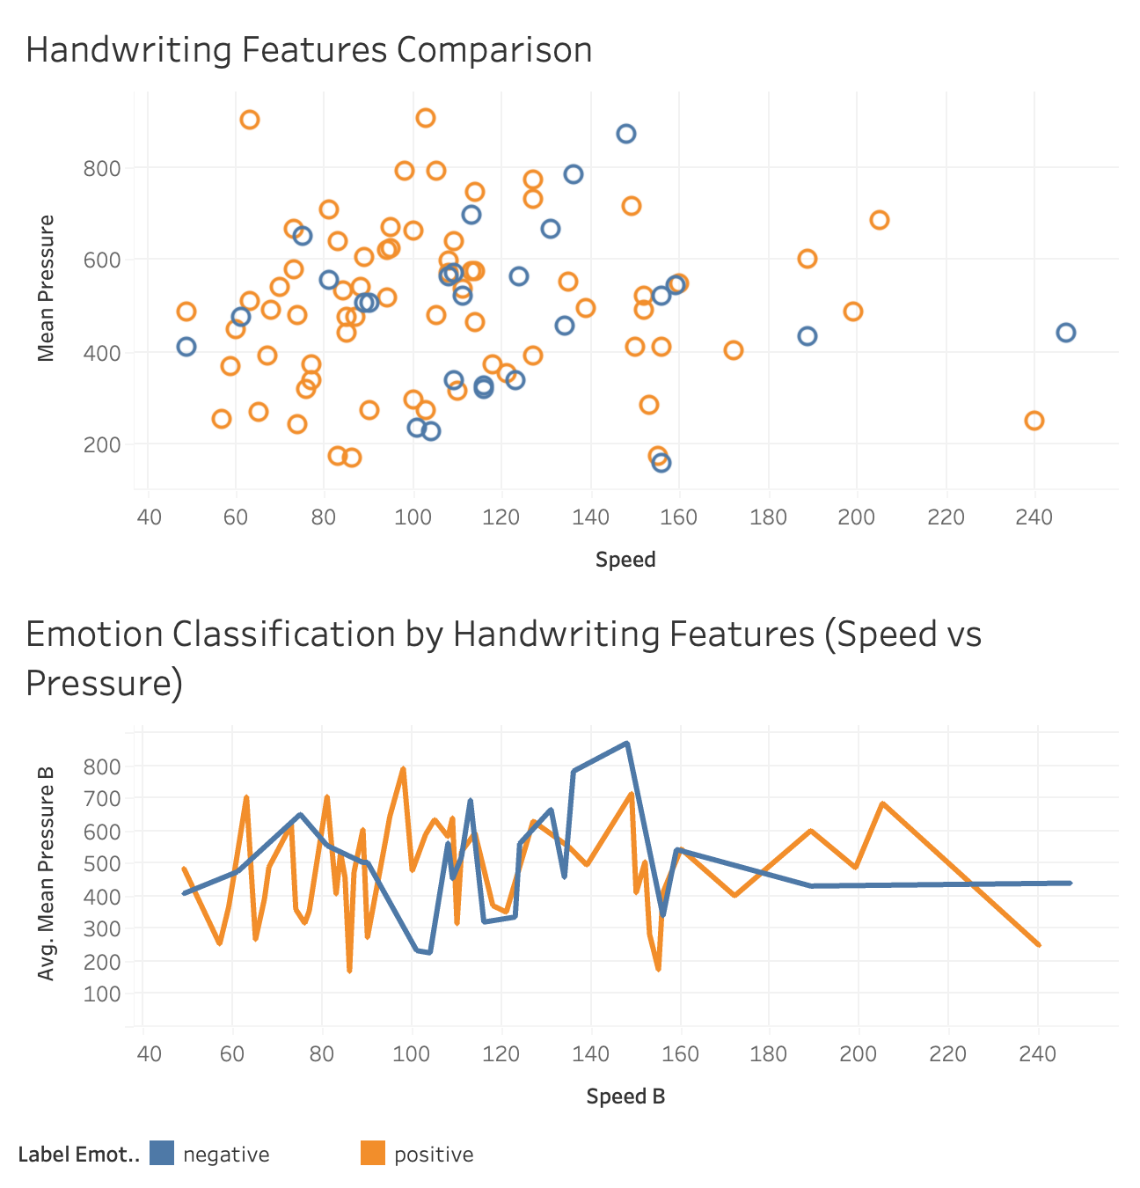

Slide 7
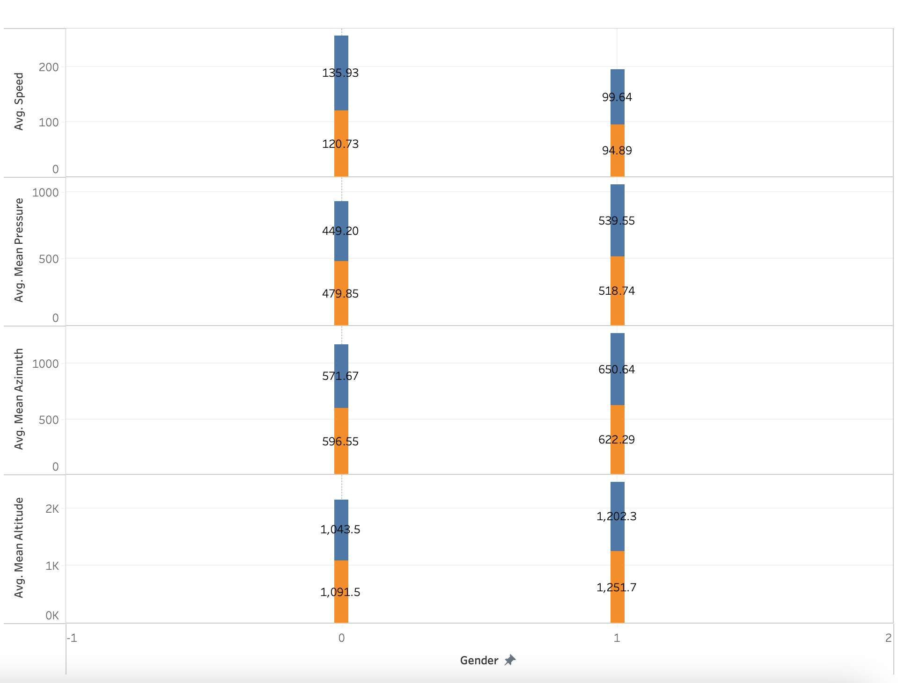

Slide 8

Model Training
Feature and Target Select
Data Splitting
Data Scaling
Random Forest Model
Optimizing Model
Notes:
Feature and Target Select
Dropped unnecessary columns “Label Emotion_y” and “Student Id” to define features (X)
Set “Label Emotion_y” as the target (y)
Dataset shape: 120 rows, 18 features
Data Splitting
Data was split into training (90%) and testing (10%) sets using train_test_split()
Data Scaling
StandardScaler was used to scale the features for both training and testing data
Random Forest Model
A random forest classifier was trained on the scaled training data
Model saved as ‘rf_model.joblib’
Initial accuracy of 91.67% and classification report showed high performance
Optimized Model
Optimized Random Forest achieved 100% accuracy on the test set
The classification report showed perfect precision, recell, and F1-score
Optimized model saved as ‘optimized_rf_model.joblib’

Slide 9

Challenges
Data imbalance
CSV file download code creation
Testing process
Notes:
Data Imbalance: Managing skewed datasets, which impact the accuracy of model predictions.
CSV File Download Code Creation: Developing efficient code to enable the download of CSV files for data analysis and reporting.
Testing Process: Addressing complexities in the testing phase, particularly in the writing and validation of test cases.

Slide 10

Future Development
Disease detection (Parkinson & Alzheimer’s)
Age-Inclusive handwriting analysis
Multilingual sentiment analysis
Handwriting style adaptation
Handwriting rehabilitation monitoring
Notes:
Disease detection: Expand the model to detect early signs of neurodegenerative diseases like Parkinson’s and Alzheimer's through handwriting patterns. By analyzing features such as tremors, slowness, or irregularity in handwriting, the model could assist in early diagnosis.
Age-inclusive handwriting analysis: Enhance the classifier to recognize handwriting patterns across a broader age spectrum, from children to seniors. This could involve retraining the model with diverse age-specific datasets to improve accuracy for different developmental and cognitive stages.
Multilingual sentiment analysis: Extend the model to support multiple languages. Handwriting styles can vary significantly between languages, so developing algorithms that recognize handwriting in various scripts and associate it with sentiment could make the model more globally applicable.
Handwriting style adaptation: Incorporate learning techniques that adapt to different individual handwriting styles, improving the classifier’s robustness to variations in letter shapes, size, or slant. This could be achieved through style transfer methods or personalized handwriting models.
Handwriting rehabilitation monitoring: Create a module to track the progress of individuals undergoing rehabilitation for motor control issues. The system could analyze improvements in handwriting to monitor recovery from conditions like stroke or hand injuries.

